Slide 1

Transformers and BERT
A quick, semi-supervised tour

Slide 2
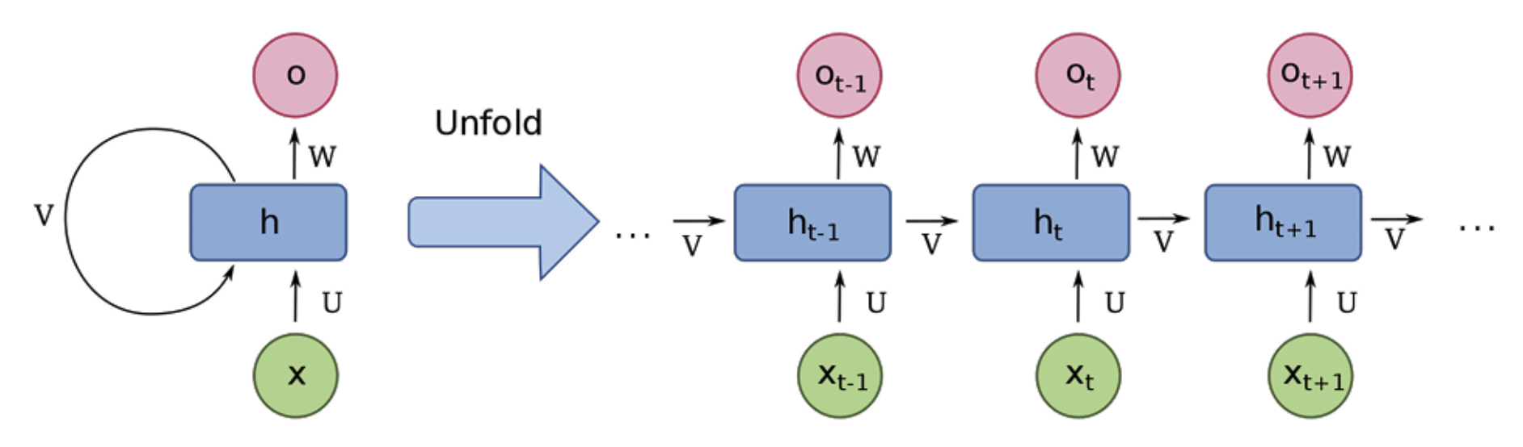
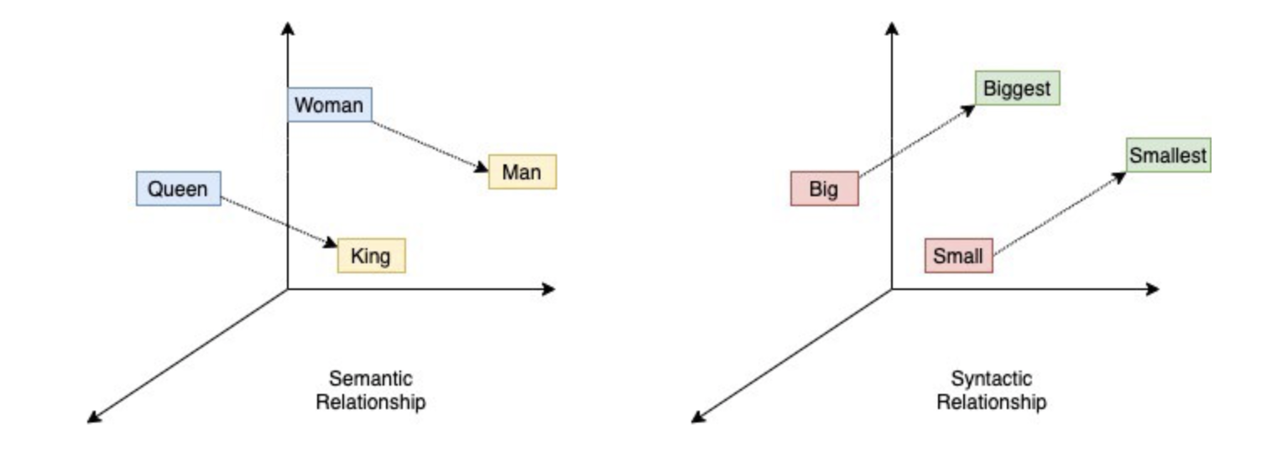
Before Transformers...
Recurrent Neural Networks
Static Word Embeddings
Consider input in order → good idea for NLP
Maintain some memory that gets updated at every time step
Commonly encoder-decoder architectures
Produce numerical representations of words that are meaningful
Can be pre-trained, used for many tasks
Word2vec, GLoVE
Notes:
-Ok so first let’s start with a quick recap of the state of NLP and text representations before 2017 and the dawn of Transformers. I know some of this will be review, but bear with me, there will lots of exciting new stuff
-So let’s start with recurrent neural networks, or RNN’s. RNN’s are a technique for for modeling time series data, where your data inputs are coming in over time. They’ve been around for a long time, but really started to come to the forefront of NLP around 2010 when people figured out new and better ways to train them.
-They quickly became the state of the art in NLP, especially for generation tasks but also for sequence classification, document reading, and most any other NLP task you can imagine
-RNN’s are commonly used with encoder/decoder architectures, where you have one network that might encode, or read in an english sentence, and a second network that decodes the encoder representation, let’s say into French.
-Ok so those are RNN’s, and they were really the blunt instrument with which one could approach any problem until about 5 years ago.
-While all that was happening, another line of NLP research was focusing on producing meaningful word representations.
-Whereas RNN’s really specialize in representing sequences, techniques like Word2Vec and Glove were more focused on how we can represent individual words. These word representations can also be combined to represent a whole sequence and this actually works pretty well, but in general they were really focused on the representations of individual words.
-This was very useful for performing tasks like analogies, and really gave rise to the idea of pre-trained models in NLP, where even if training an RNN on some task would perform better, people would prefer to use a pre-trained model like Glove or word2vec because it was good enough and it was easier.

Slide 3
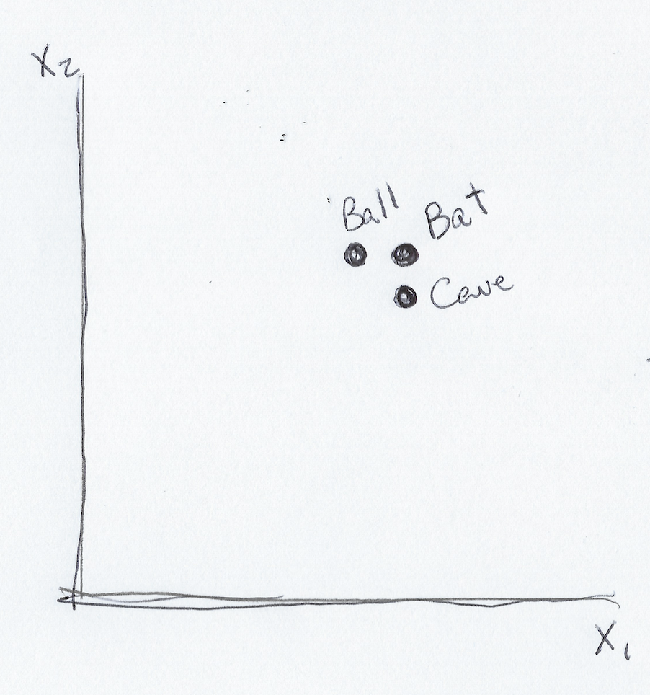
Weaknesses of Static Word Embeddings
Insurmountable weakness:
Word meanings are the same in every context
We need a bat and ball to play.
The bat returned to its cave for the day
“Bat” has same representation!!!
Notes:
-However, while word embeddings were enormously useful and really pushed the field and many benchmarks forward, they had one giant, glaring weakness that pretty much doomed them from the start.
-And that is the fact that for a given word, these models return the same numerical representation no matter what the surrounding context.
-So if you have two sentences, ‘we need a bat and ball to play’ and ‘the bat returned to its cave for the day’, a model like GLOVE or word2vec is going to return the same numerical representation in either case.
-So you can imagine that is just a giant limitation, because if I want to perform some task with that word, like matching words in a caption to objects in an image, it seems pretty important that I know whether the bat seems to be a baseball bat or a winged creature based on context.
-So while these methods were super successful and a great step forward, there was a need for a better way of representing words in a sequence.

Slide 4
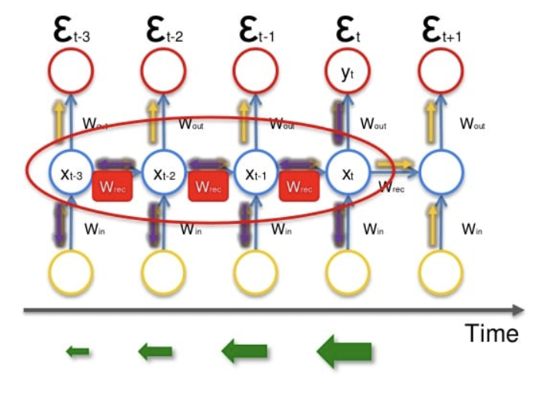
Weaknesses of RNN’s
Slow to train → have to perform back-propagation through time
Memory cell is constantly overwritten, makes it hard to learn long-term dependencies
“Sita asked Rukmini to make her some tea because she was cold.”
Who does “she” refer to?
Vanishing and exploding gradients make it very hard to train RNN’s over many time-steps!!!
0.9**50 = 0.005153
1.1**50 = 117.4
Notes:
-So now let’s look at RNN’s and why this wasn’t the ultimate solution in NLP.
-Basically the main thing here is that RNN’s are just brutally slow to train.
-You have to perform back-propogation through time, so for a sequence length of 100, which really isn’t even that long, backpropogation takes 100 separate steps, no matter how many GPU’s you have or how much parallel hardware.
-So that was really the main limitation of RNN’s, that they were just very slow to train, with the biggest RNN’s never getting more than 8 or so layers deep while Image networks being developed at the same time were stacking 100’s of layers.
-Also, in RNN’s you have this information bottleneck where there’s just this one memory cell that’s supposed to hold all of the information you need to represent a sequence and it is constantly overwritten.
-So if you have a long sentence, by the time you get to the end it’s unlikely that you’ll have the information necessary to answer questions about words from the beginning of the sentence.
-Here’s an example of such a task
-Finally, not to get too into the weeds but RNN’s also suffer from vanishing and exploding gradients, which make them rather difficult to train.

Slide 5
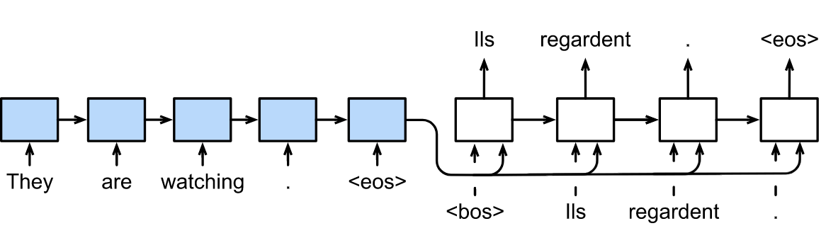
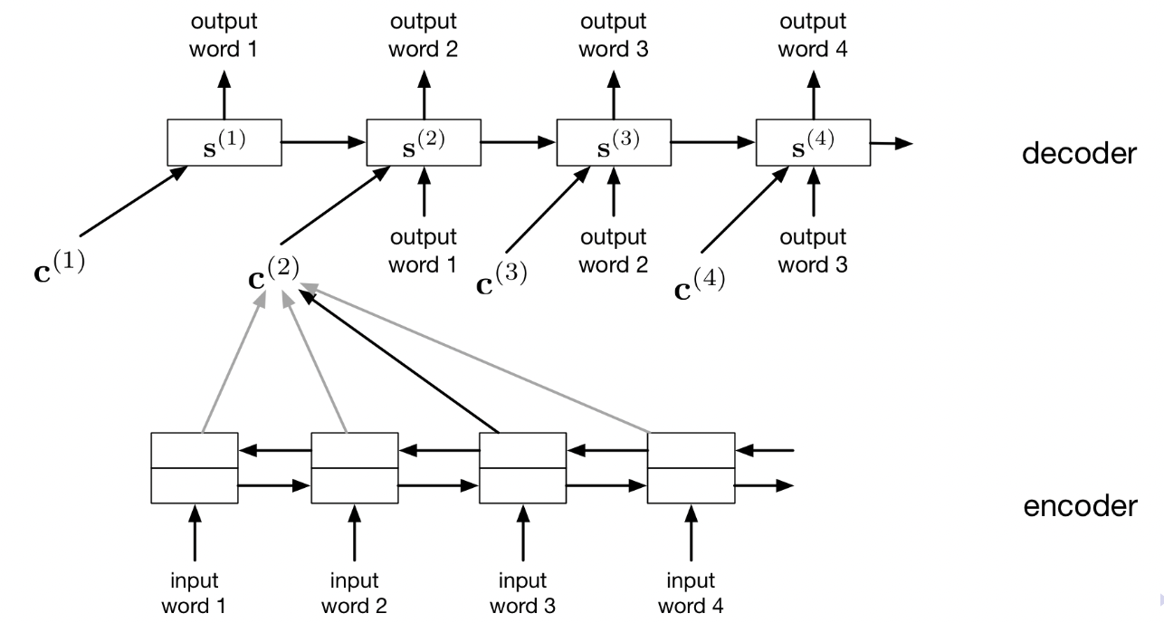
Attention
Main Idea: Word should be represented based on context
Mechanism: At every position, be able to directly access every position
Notes:
-Ok so now let’s pivot a bit and talk about attention.
-The main idea in attention is that a word should be represented based on all available context.
-Ok so when you’re decoding this word here, you want to have access to all of these words over here
-With an RNN, this isn’t exactly possible, because it’s likely that information about the beginning of the sequence has been lost.
-So attention has this mechanism, where the main thing you need to understand is that at every position, you’re able to directly access every positon.
-Use chart, give example

Slide 6
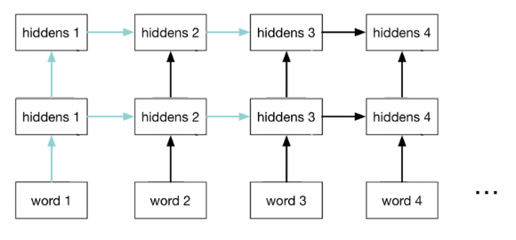
Is Attention All You Need?
We would like our model to have access to the other words in a sentence when building the representation of some word
Previously we achieved this by having the recurrent connections.
This meant we had to backprop through time
Typical sequence length = 128, 512, 1024, etc.
layers
Backprop happens in opposite direction from arrows
Time
Notes:
-So the point of all this, attention and RNN’s, is that we would like our model to have access to the other words in a sentence when building the representation of some word
-Previously we achieved this by having the recurrent connections.
-So as you can see here, the word in position 3 gets it information about the other words through these lateral connections…
-However, as I mentioned earlier, this meant we had to backprop through time. Backprop is computer in the opposite direction from these arrows, so to compute the gradient at position….
-With typical sequence lengths, this could be very slow, even if there was only one or a few layers

Slide 7
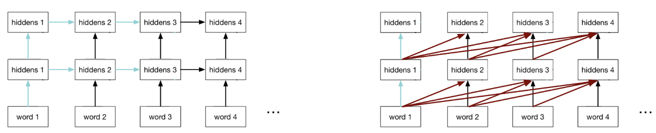
Attention Is All You Need
Backprop happens in opposite direction from arrows
layers
RNN
Transformer
Transformer removes connections within a layer, gets context information from previous layer
Makes training much easier, because we backprop through layers instead of time
Typical # of layers: 5-50 (compared to sequence length >= 512)
Notes:
-However, in 2017 some very smart people figured out that in fact we don’t need these lateral connections to get the information from other words.
-Instead, we can just look directly at every position in the layer below when we’re computing the representation of some cell.
-For example, for hiddens 3 in the second layer here…
-So with these lateral connections removed, backpropogation is now occurring layer by layer. We can compute all of the gradients for layer 3, then all of the gradients for layer 2, and so on
-So even if we want to stack 50 layers deep, we’re still doing 1/10th of the computation being done by an RNN with a single layer and sequence length 512.
-And this is the idea that was introduced in a very famous 2017 paper, Attention is All you Need.
-Everyone thought we needed these recurrent connections, whether or not you wanted to add attention, but these people came along and said no and threw these out and gave us the transformer.

Slide 8

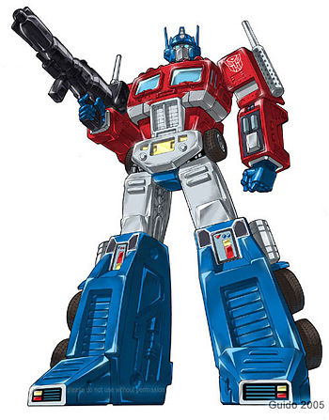
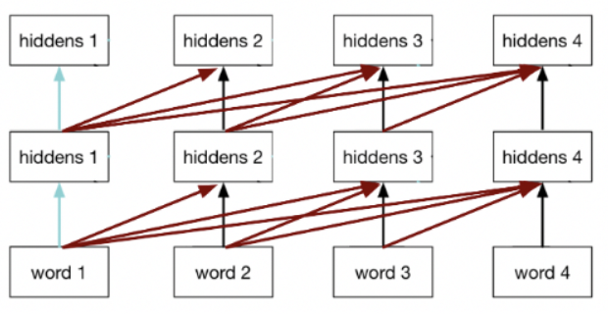
Transformers
Original paper: “Attention Is All You Need”
Main idea: we can throw out recurrent connections and just use attention
Overcome RNN Weaknesses:
Train faster: no more recurrent connections
Train more easily: skip connections
Overcome word2vec Weaknesses:
Words embeddings are now contextual!!!!
Notes:
-So now just a little bit more on Transformers.
-Like I said, the original paper is Attention is all you need. If there’s one NLP paper I’d suggest reading and trying to understand it’s this. It’s a relatively straightforward paper as far as this stuff goes, it still took me a few tries to understand but it’s well written and extremely foundational so I do suggest people at least google it and click the link at some point.
-The title really encapsulates the main idea well, as well as the state of the field in which it was produced, but it’s all out this realization that we can throw out recurrent connections and just use attention.
-It overcame the weaknesses of RNN’s because…
-And then I’ll illustrate this more in a later slide, but it overcame the weakness of word2vec because we need had pretrained models that produced contextual word embeddings, where a different representation was returned depending on a word’s surrounding context.
-The main thing that really happened here is that bigger models became easier to train. If you took a modern transformer and added these lateral connections back in, they’d take a million years to train, they’re just so much bigger than RNN’s were ever able to become.

Slide 9
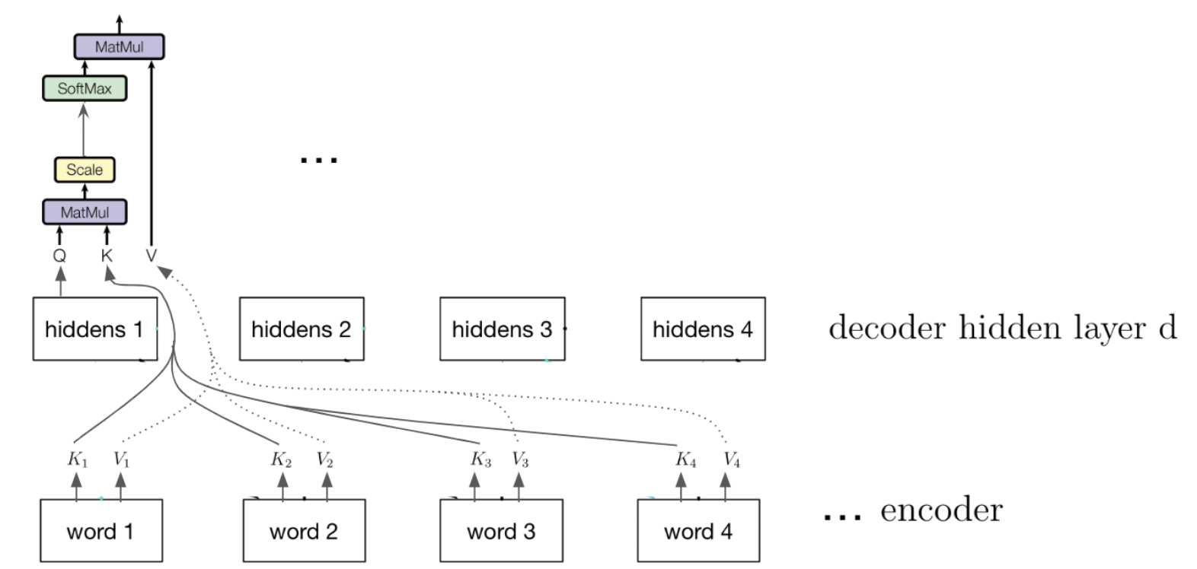
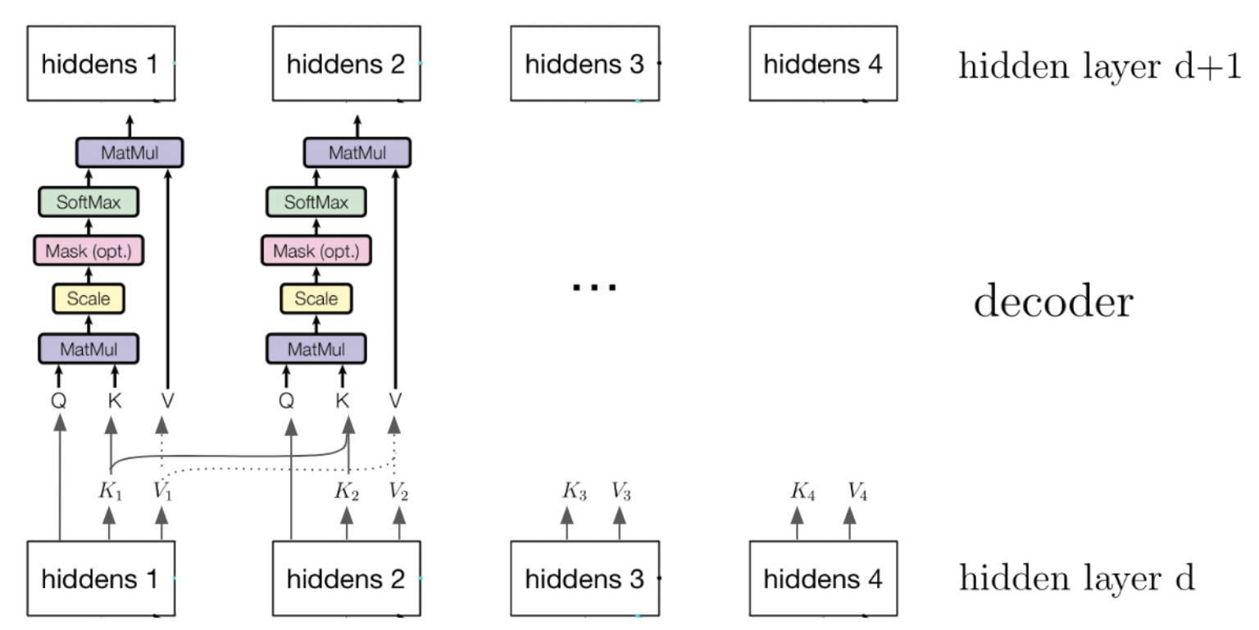
Attention in Transformers
Transformer
Encoder Cross Attention
Decoder Self Attention
Notes:
So now let’s take a quick look at how attention works in Transformers.
-Here you’ll see a diagram of the full transformer architecture.
-It has an encoder and decoder
-It is performing attention computations in a couple spots
-This is a lot of bookkeeping and I wouldn’t worry about memorizing all this, I just think it’s worth peaking at but the main takeaway here is that every word is looking directly at every other word.

Slide 10
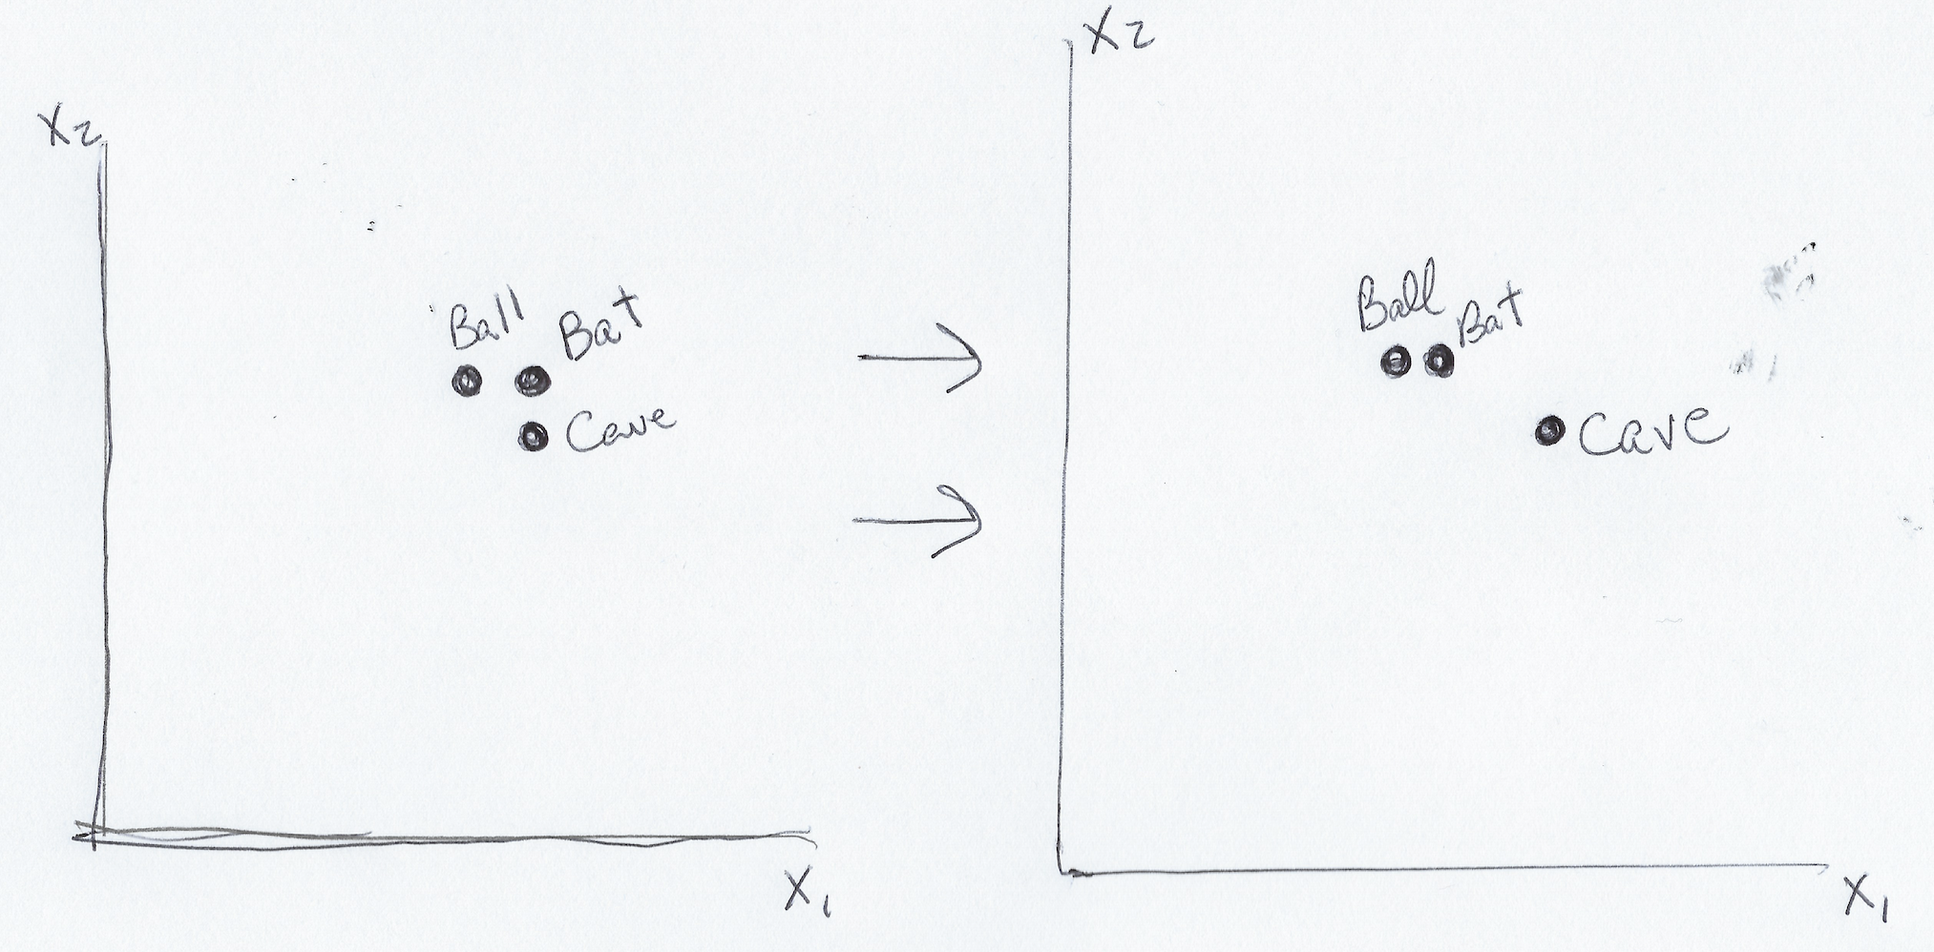
Contextual Word Embeddings
Transformers build a representation of a word that is sensitive to surrounding context!!!!
E.g. “You need a bat and ball to play” → meaning of bat should be closer to ball than cave
Notes:
And this brings us to contextual word embeddings, which is one of the great innovations of Transformers.
-Transformers build a representation of a word that is sensitive to surrounding context.
-For example, in the sentence “You need a bat and ball to play”, the meaning of bat should be closer to ball than cave
-So this was huge, the downside is that I need to load a whole model to produce these, whereas with word2vec or glove you just had to load the embedding dictionary, but if you do have the memory and compute necessary it’s just an infinitely better way to produce representations of words.

Slide 11
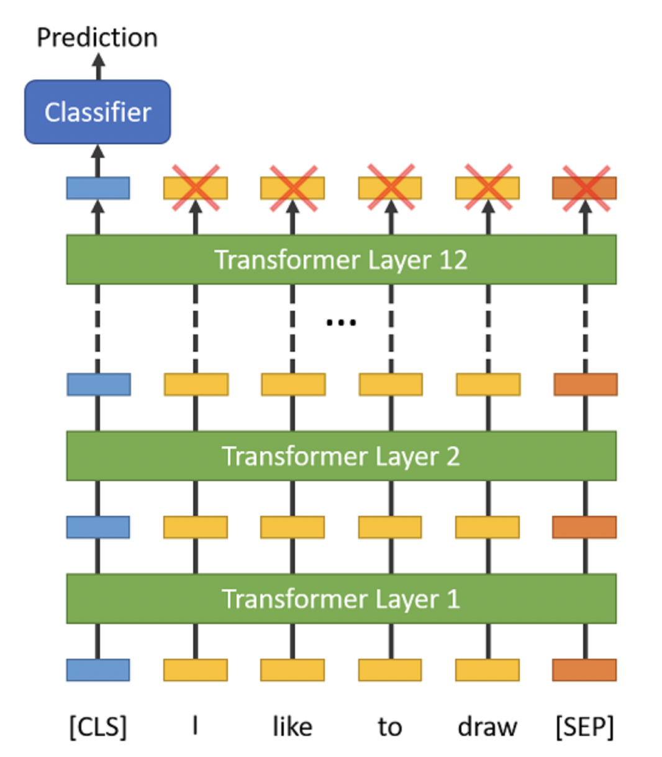
BERT Is A Transformer Encoder Only!
Original Transformer: Encoder-Decoder (RIGHT)
Separate networks for building representations and generating response
BERT: Encoder only (LEFT)
Single network for building representations
Bi-directional!
Notes:
Ok so now that we’ve been briefly introduced to Transformers, let’s talk about the most popular transformer out there today, BERT.
So the original transformer was an encoder-decoder architecture. Soon afterwards in 2018, a group at Google figured out that you didn’t need the decoder, especially if you were not worried about generation but more focused on representation.
Another key thing they did is they made the encoder bidirectional, which we’ve seen with RNN’s. This means that it’s reading context both from left and right, as opposed to the original transformer that just read from the left.
I’ll describe how they trained on the next slide, but the key thing to take away is that they basically took this original transformer architecture and chopped off the decoder and said we’re just going to focus on building these bi-directional representations, and not worry about decoding or generation.

Slide 12
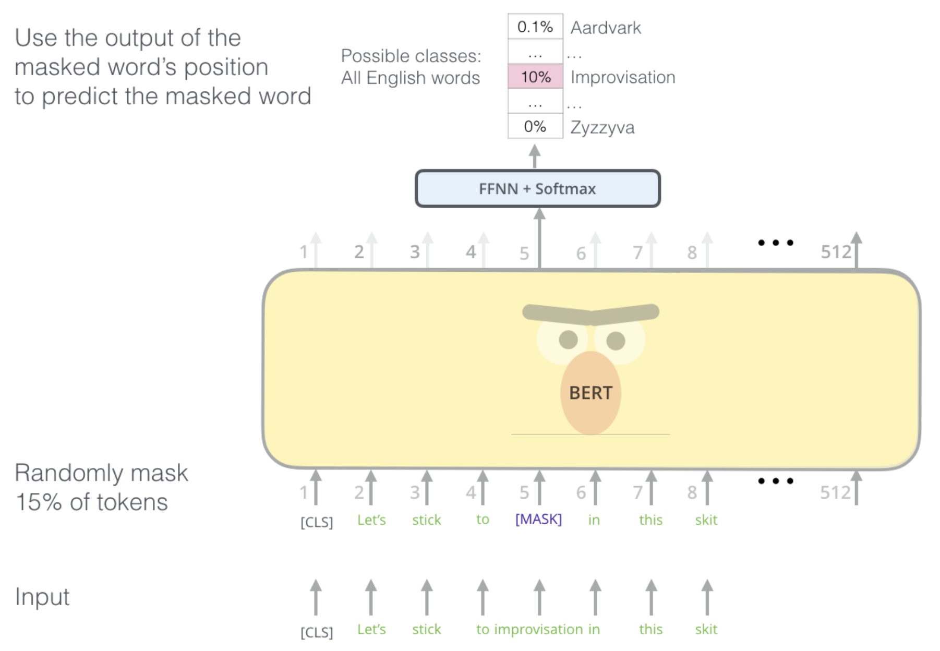
Masked Language Modeling
Original Transformer was trained to predict next word → could not capture left AND right context
BERT’s training task was masked language modeling → predicting the missing word in a sentence
Notes:
So how did they train this encoder-only architecture?
-The original transformer was trained in a left ro right fashion to predict the next word. This meant that the word at position 5 didn’t know what word was at position 10.
-On the other hand, BERT trained using a masked language modeling objective, where one or more words in the middle of a sequence are removed and the model must use the representations of the surrounding context to predict this missing words.
-Thus it learned to incorporate context not just from the left, but also from the right, and this made its representations much more powerful.
-So you can see in the diagram here…

Slide 13
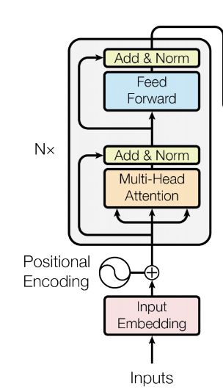
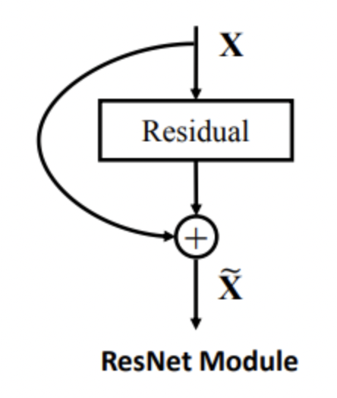
Residual Connections
Residual (or skip) connections are extremely popular in deep neural networks today
Each layer adds information to input instead of generating from scratch
Stabilizes training
Allows gradients to flow more easily
Input size = Output size!
Enables modularity and deep stacking

Slide 14
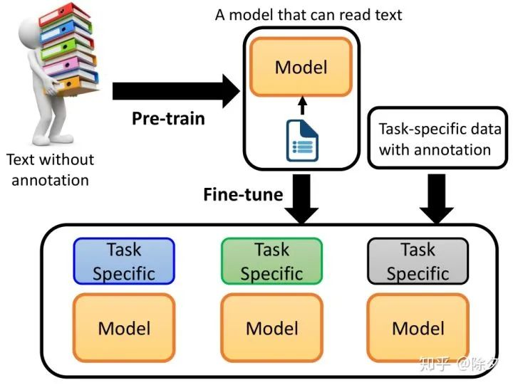
Pre-trained Language Models
BERT is an example of transfer learning → train model on GIANT dataset, TRANSFER knowledge to many tasks
Most useful representation of a word might be different based on your task, but pre-trained models are a great starting point for many, many tasks!!!

Slide 15
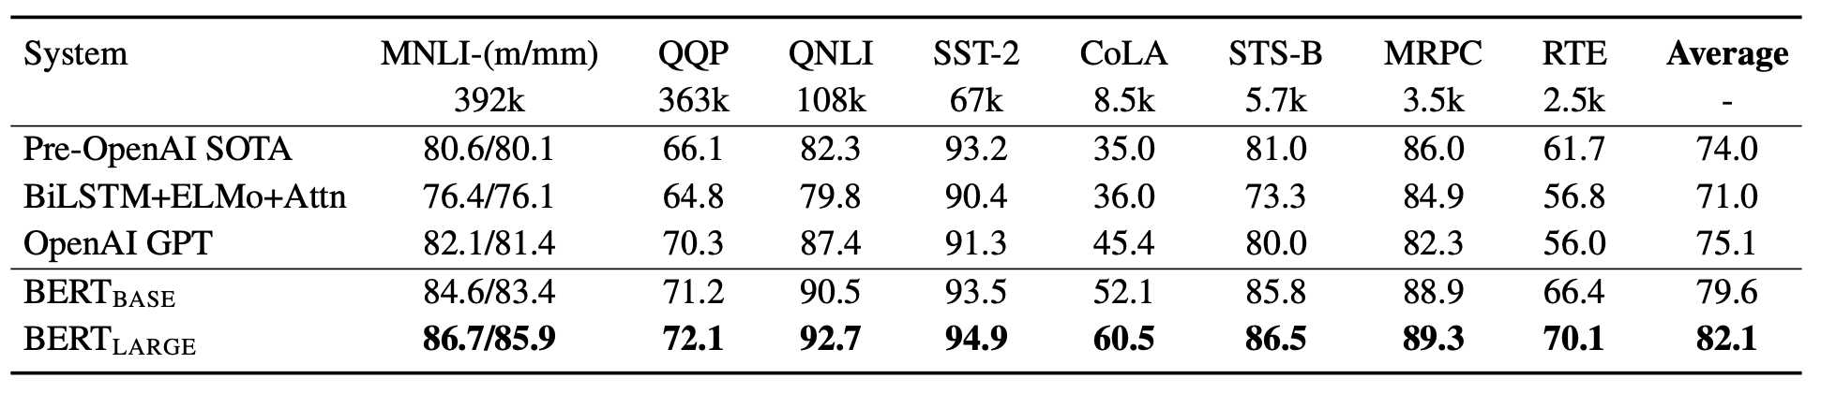
What Can I Use BERT For??
Short answer = everything
But better at some things than others
Best at:
Question Answering
Sentiment Analysis
Natural Language Understanding
Natural Language Inference
Also good at:
Translation, Generation
Why? Bi-directional vs. Left-to-right
But wait for GPT if you want to generate text!
BERT specializes in representing input
Where to start?
Pretrained models on Huggingface!!!

Slide 16

Huggingface Demo!

Slide 17
Possible Use Case
Use semantic similarity and sentiment analysis to predict Apple stock price
Step 1: Scrape web for each day’s news as well as Apple’s stock price
Step 2: Use semantic similarity scores between prompts and articles to pick out news relevant to Apple
e.g. seed with phrases like “cell phone purchases”, “holiday shopping numbers”, etc.
Step 3: Compute sentiment score
average, median, min, max?
Create machine learning model to predict stock movement based on recent sentiment about company
Previous day, but maybe better as a moving average?

Slide 18
BERT4Rec
BERT is a good architecture for modeling all kinds of sequences!
What will the next frame in a video be based on previous frames?
What will the next item purchased by a user be based on previous purchases?
BERT4Rec → Instead of inputting a sequence of words, input a sequence of items
Discover complex patterns in the ordering of how users consume content, purchase goods, etc.
What other types of sequences could be modelled in this way?

Slide 19
Thank you!
Tom Zollo
tpz2105@columbia.edu

